Slide 1


JavaScript Basics
Classes, Inheritance

Slide 2
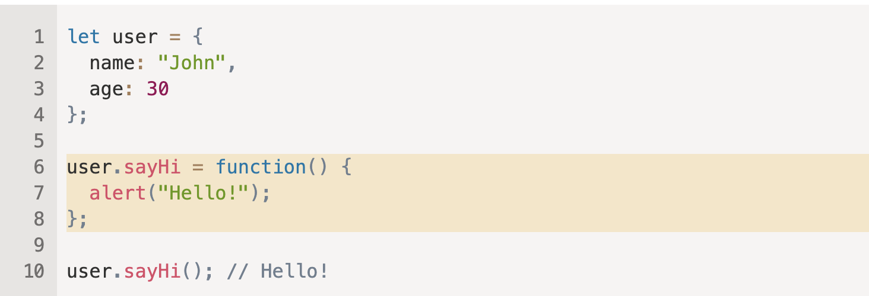
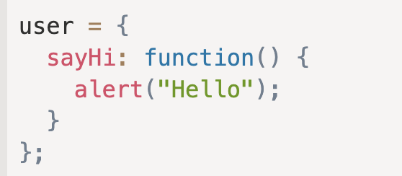
Object Methods

Slide 3
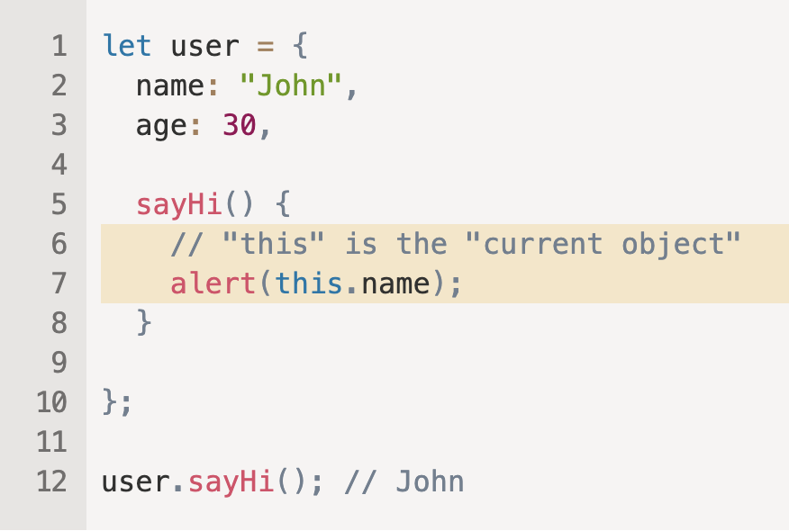
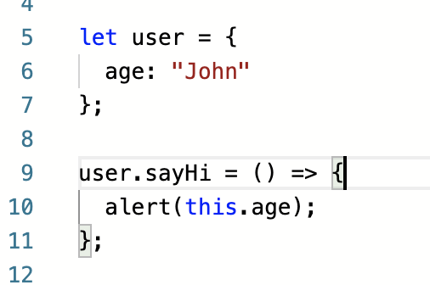
this keyword
Arrow functions have no “this”
Result will be undefined

Slide 4
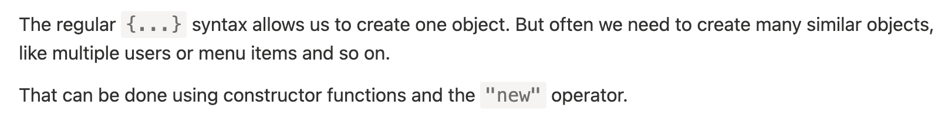
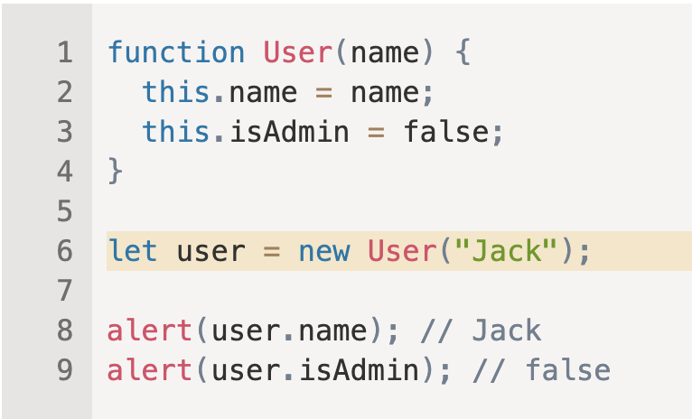
Constructor, operator new

Slide 5
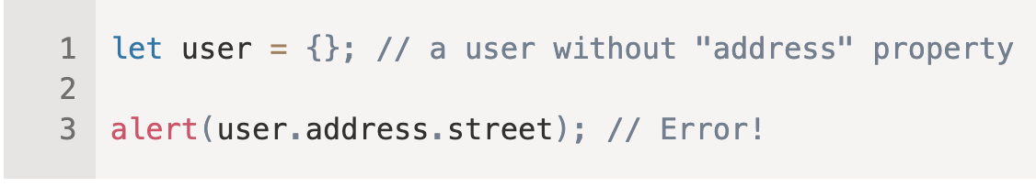
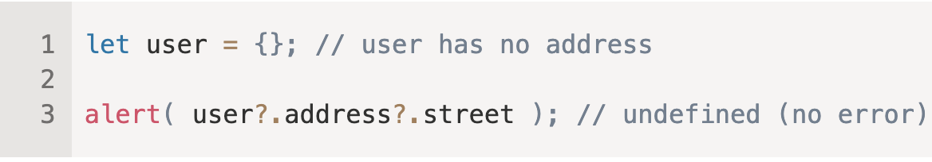
Optional chaining '?.'

Slide 6
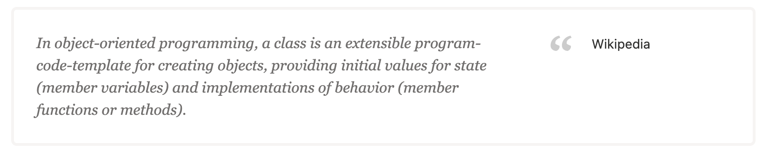
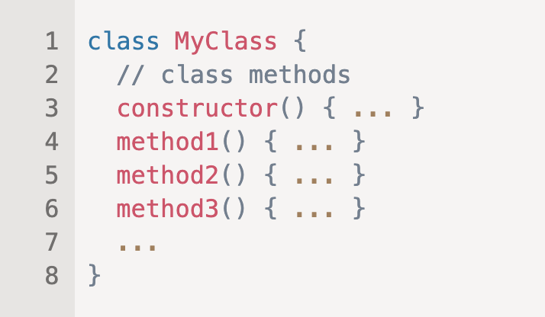
Class

Slide 7
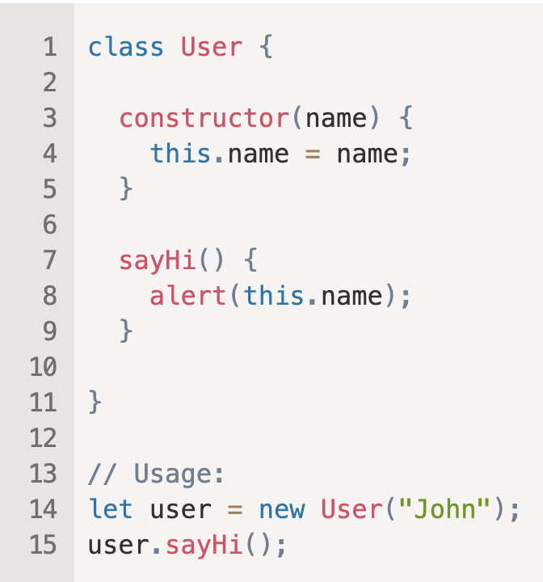

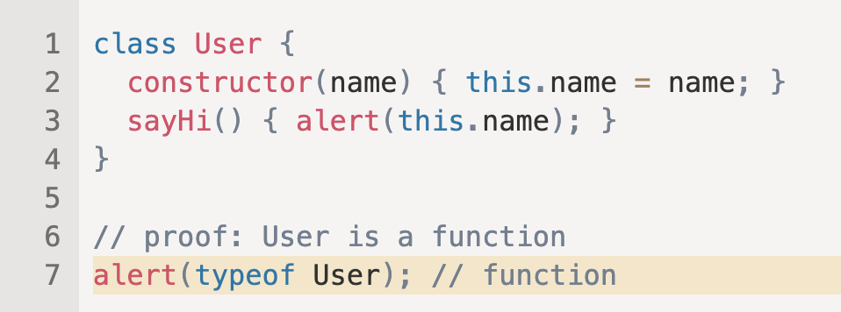

Slide 8
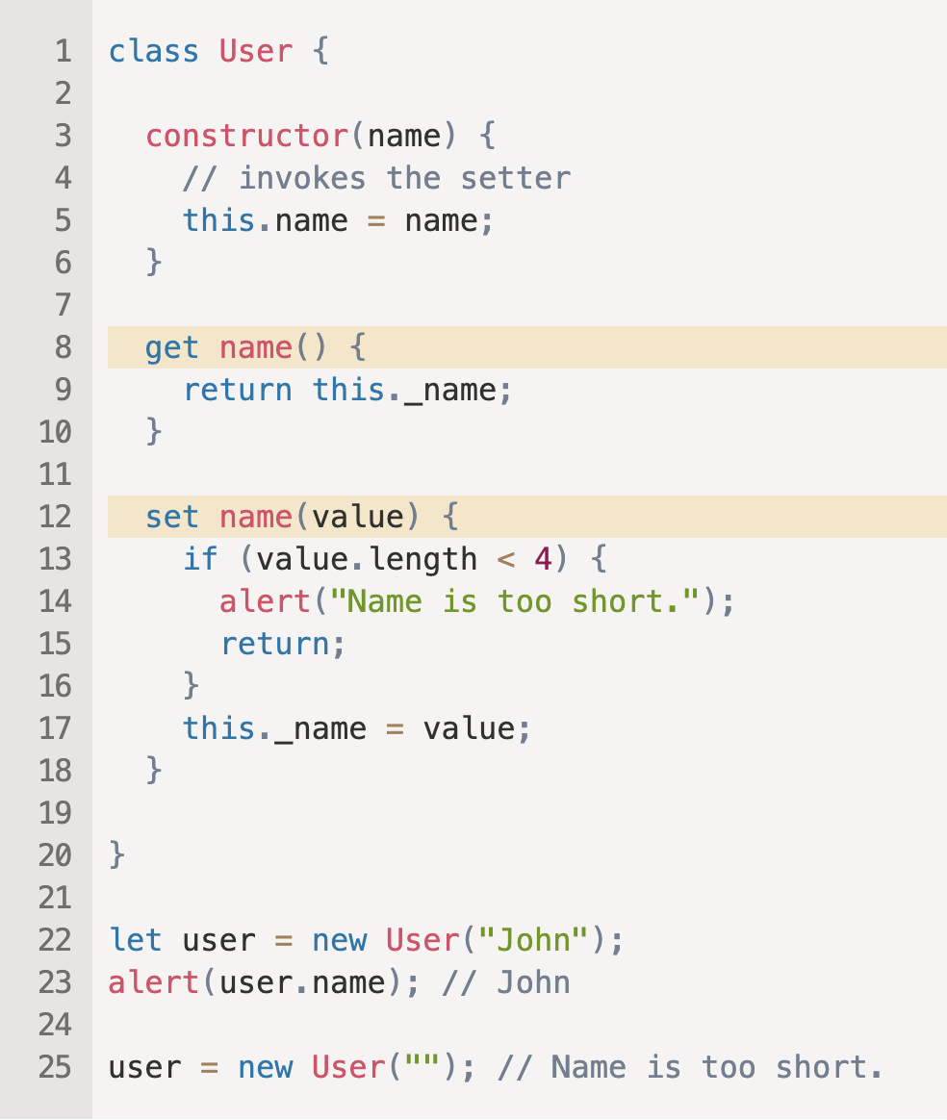
Getters/Setters

Slide 9
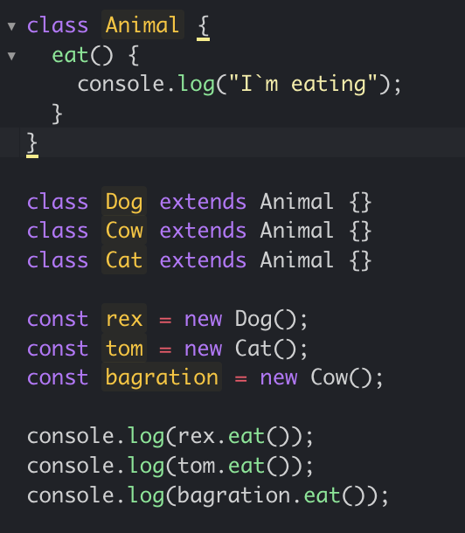
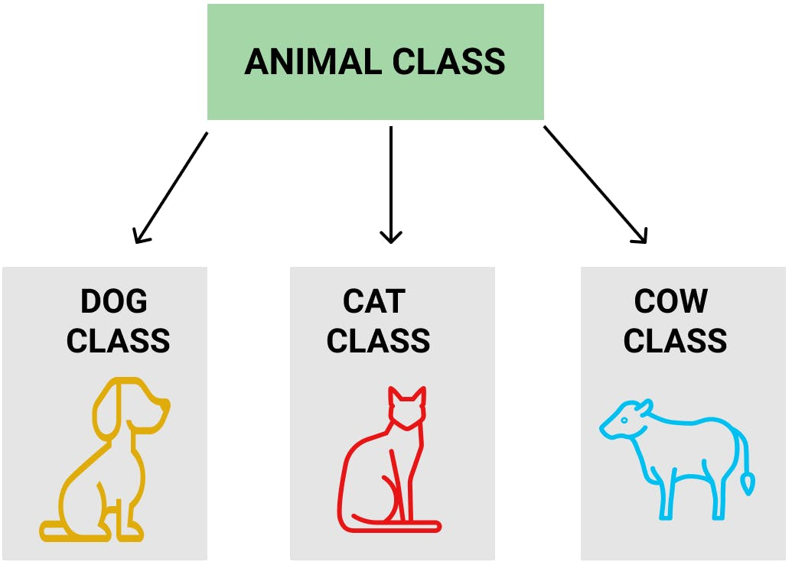
Class Inheritance

Slide 10
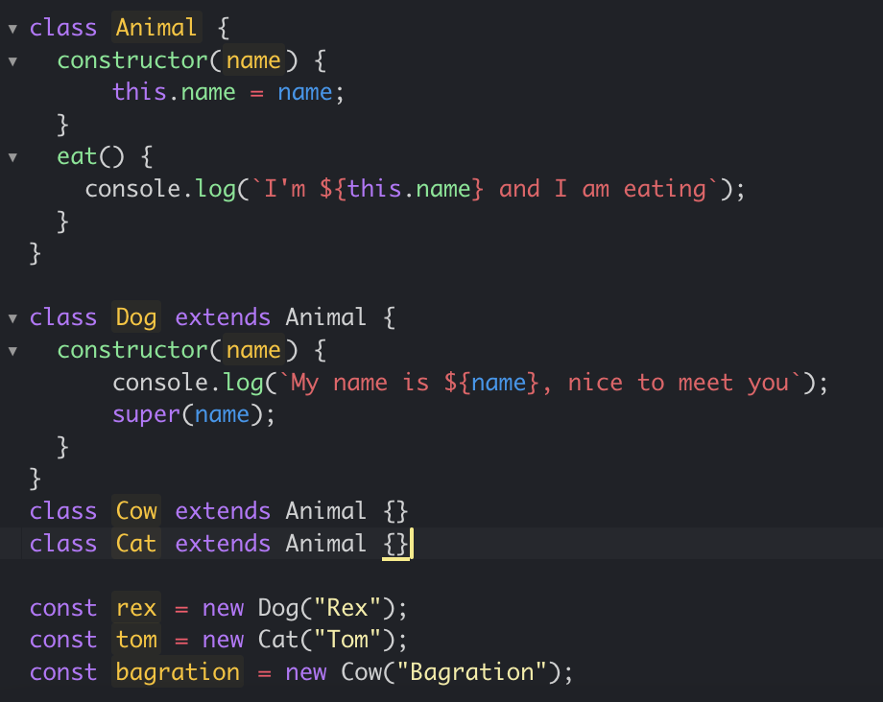
super()

Slide 11
Tasks
Create a BMW, Mercedes, Audi classes extended from Car class
1.2. All cars must have a name which is not changeable(Show warning message when someone will try to do it).
1.3 Cars must have color, width, bodyMass, maxSpeed properties.
1.4 All cars must have getInfo() method which will return all info about car.
1.5 BMW class must have `sportMode()` method which will change mode of car to sport.
1.6 Mercedes must have `ecoMode()` method which will change mode of car to eco.
1.7 All Cars must have drive() method which will log info like You are driving white Bmw which is now on eco mode and max speed is 260km/h or You are driving white Bmw which max speed is 180km/h

